Slide 1

SRM INSTITUTE OF SCIENCE AND TECHNOLOGY SCHOOL OF COMPUTING
DEPARTMENT OF COMPUTER SCIENCE AND ENGINEERING
18CSP107L / 18CSP108L - MINOR PROJECT / INTERNSHIP
Sentiment Analysis Dashboard On Social Media Presence
Guide name: Dr.Amit Kukker
Batch ID:
Student 1 Reg. No: RA2111003030219
Student 1 Name: Sunidhi Singh
Student 2 Reg. No:RA2111003030213
Student 2 Name: Nimit Kwatra
Student 3 Reg. No: RA2111003030208
Student 3 Name: Devesh Tomar
Student 4 Reg. No: RA2111003030224
Student 4 Name: Shrikant Choudhary
Designation: Associate Professor
Department: CSE

Slide 2
Abstract
Mental health is a crucial aspect of people’s lives, and its neglect in some industries can impact work performance. Many people are dissatisfied with their work environment, which can affect the company’s performance if it’s not comfortable or causes problems. The dashboard will visually display the sentiment of customer feedback on social media, showing the percentage of positive, negative, and neutral sentiment, and highlighting common topics and keywords. This technique can analyze a person’s emotions and opinions, helping to detect their mental health status or the problems they’re facing. Sentiment analysis can be used to evaluate various types of content, including customer messages, online reviews, and social media posts. The project will utilize Natural Language Processing (NLP) and deep learning techniques such as LSTM model to achieve maximum accuracy in sentiment analysis.

Slide 3
Introduction
Social media has become a major platform for people to connect, share information, and express themselves.
This generates a massive amount of data that can be difficult to analyze and find valuable insights from.
Sentiment analysis is a technology that uses artificial intelligence to interpret the emotions conveyed in social media content.
The "Sentiment Analysis for Social Media" project aims to develop a system that can decipher the wide range of emotions expressed online.
Understanding sentiment is important because social media significantly impacts public opinion, business reputation, and individual views.
This project detecting positive or negative sentiment by using natural language processing and machine learning to provide a more comprehensive understanding of user sentiment. This allows businesses, organizations, and individuals to make better decisions and navigate the complexities of social media communication

Slide 4
Manual Analysis Traditionally, sentiment analysis on social media involves manual inspection of posts, tweets, and comments, which is time-consuming and prone to human bias. Basic Analytical Tools Current tools provide limited insights, often only showing basic metrics like likes, shares, and comments without deeper sentiment analysis. Data Overload With the massive volume of social media data, existing systems struggle to process and analyze data in real-time, making it challenging to gain timely insights.
Existing System

Slide 5
Problem statement and Objectives
In the current digital age, social media platforms have become a significant source of public opinion and customer feedback.
The challenge lies in harnessing this vast amount of data to gain valuable insights into how an organization’s products, services, or brand are perceived by customers.
Social media platforms can provide valuable insights into how customers perceive an organization's products, services, or brand through data.
Also having a user-friendly interface to visualize the results of the sentiment analysis.

Slide 6
Proposed System
Data Preparation:
Load dataset.
Split into training and testing data.
Model Architecture:
Define Sequential model.
Add Embedding layer.
Add Dropout layer for overfitting prevention.
Add LSTM layer.
Add another Dropout layer.
Add Dense output layer with sigmoid activation.
Model Compilation:
Compile model with appropriate function, optimization algorithm, and accuracy metric.
Model Training:
Train model on training data, validate with test data.
Model Evaluation:
Evaluate model performance on test data.

Slide 7
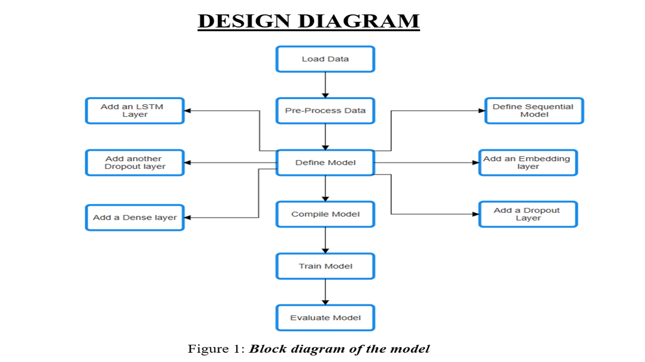

Architecture/Block Diagram of the proposed model

Slide 8
Intermediate Results and Discussion
Table 1: Performance Metrics of LSTM Model for review dataset:
SI No. | Embedding vector length | LSTM units | First Dropout layer | Second Dropout layer | Optimizer | Number of epochs | Batch size | Activation | Accuracy
1 | 100 | 100 | 0.3 | 0.3 | adam | 20 | 64 | Sigmoid | 83.38%
2 | 125 | 125 | 0.2 | 0.2 | rmsprop | 10 | 64 | ReLU | 83.61%
3 | 80 | 150 | 0.3 | 0.3 | rmsprop | 30 | 64 | ReLU | 83.75%
4 | 70 | 175 | 0.4 | 0.4 | adam | 35 | 128 | sigmoid | 84.37%
5 | 50 | 200 | 0.4 | 0.4 | rmsprop | 45 | 128 | ReLU | 86.17%
Average Accuracy obtained: 84.25%
Maximum Accuracy obtained : 86.17%

Slide 9
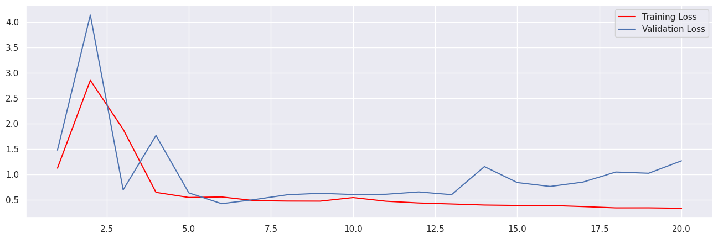
Figure 2: Loss vs Validation Loss

Slide 10
Table 3: Performance Metrics of LSTM Model for Twitter dataset:
SI No. | Embedding vector length | LSTM units | First Dropout layer | Second Dropout layer | Optimizer | Number of epochs | Batch size | Activation | Accuracy
1 | 100 | 100 | 0.3 | 0.3 | adam | 20 | 64 | sigmoid | 87.25%
2 | 125 | 125 | 0.2 | 0.2 | rmsprop | 10 | 64 | ReLU | 86.90%
3 | 80 | 150 | 0.3 | 0.3 | rmsprop | 30 | 64 | ReLU | 88.56%
4 | 70 | 175 | 0.4 | 0.4 | adam | 35 | 128 | sigmoid | 90.91%
5 | 50 | 200 | 0.4 | 0.4 | rmsprop | 45 | 128 | ReLU | 93.05%
Average Accuracy obtained: 89.33%
Maximum Accuracy obtained : 93.05%

Slide 11
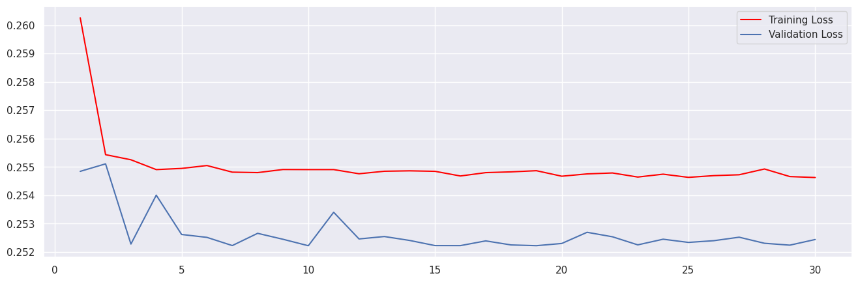
Figure 4: Loss vs Validation Loss

Slide 12
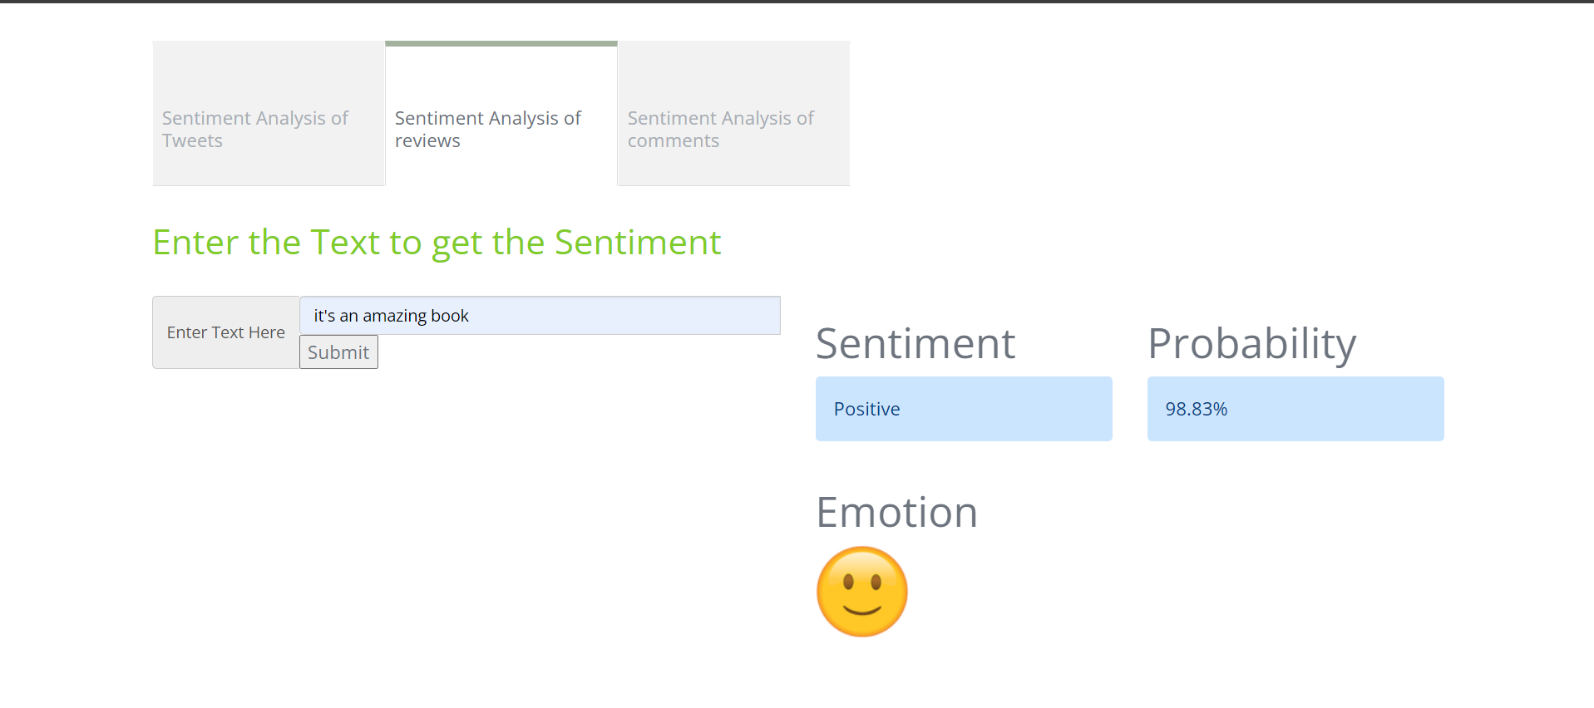
This result shows the output of sentence “it’s an amazing book”. Sentiment is positive and probability is 98.83%.
Figure 8: Dashboard Design

Slide 13
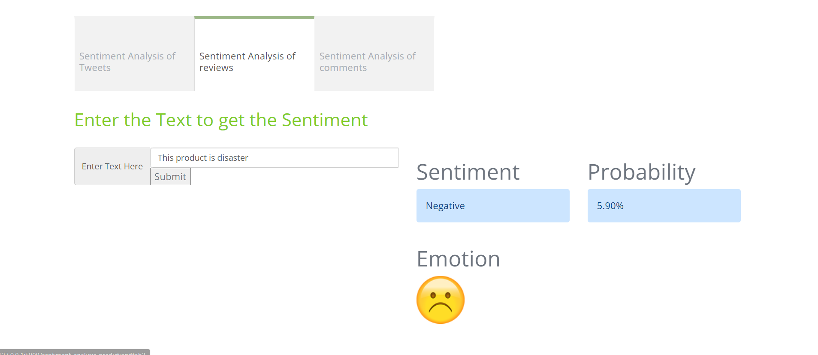
This result shows the output of sentence “This product is disaster”. Sentiment is negative and probability is 5.90%.

Slide 14
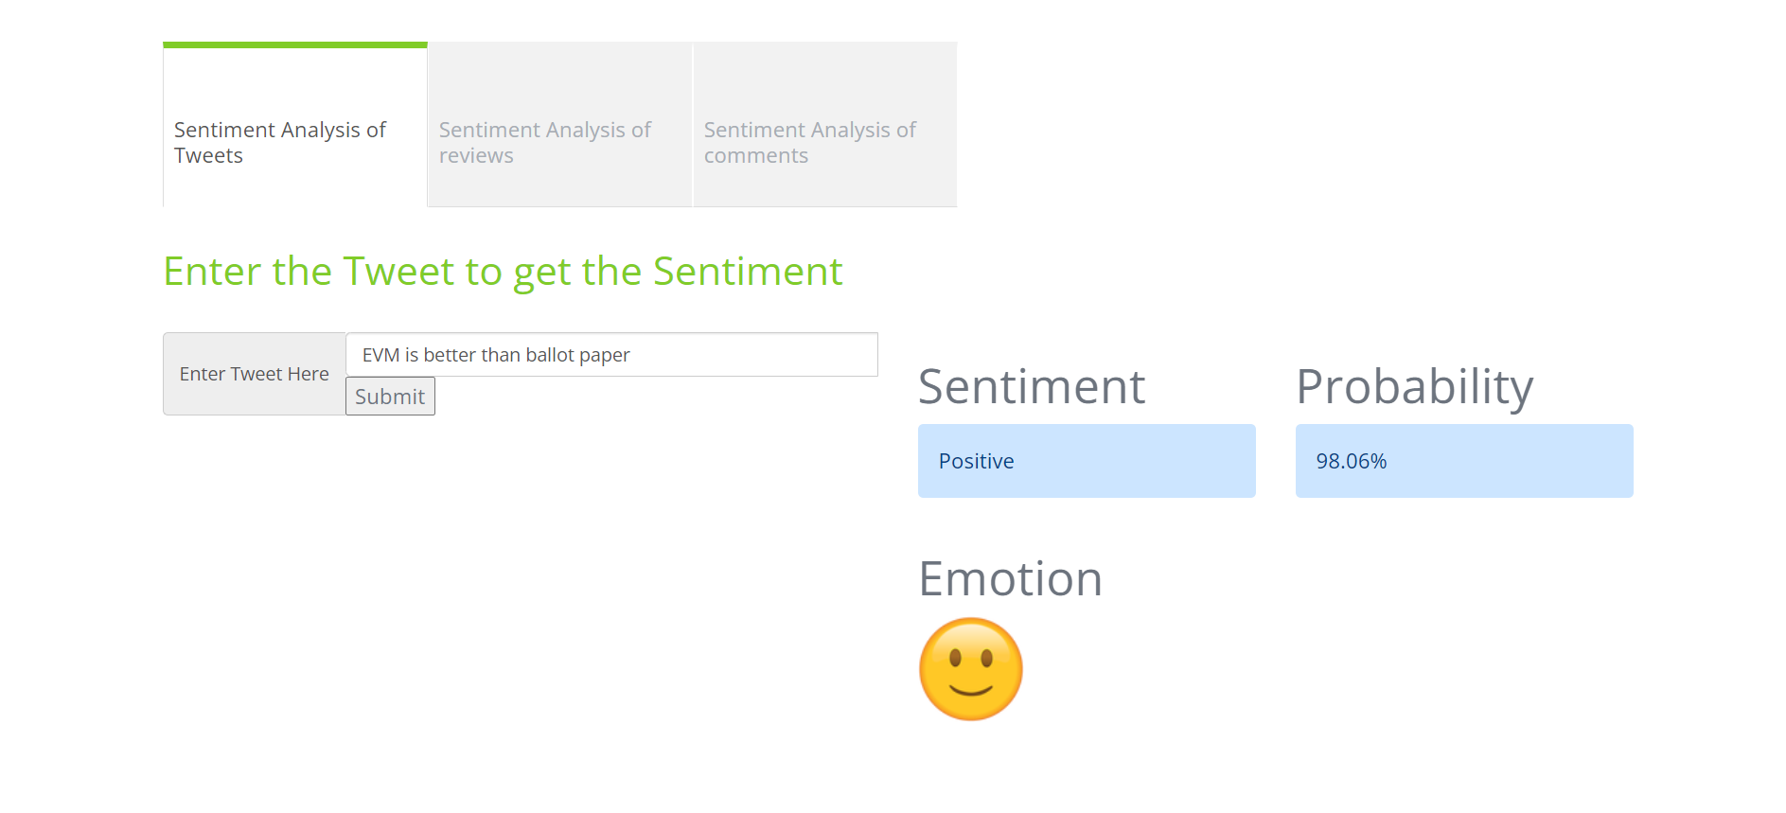
This result shows the output of sentence “EVM is better than ballot paper”. Sentiment is positive and probability is 98.06%.

Slide 15
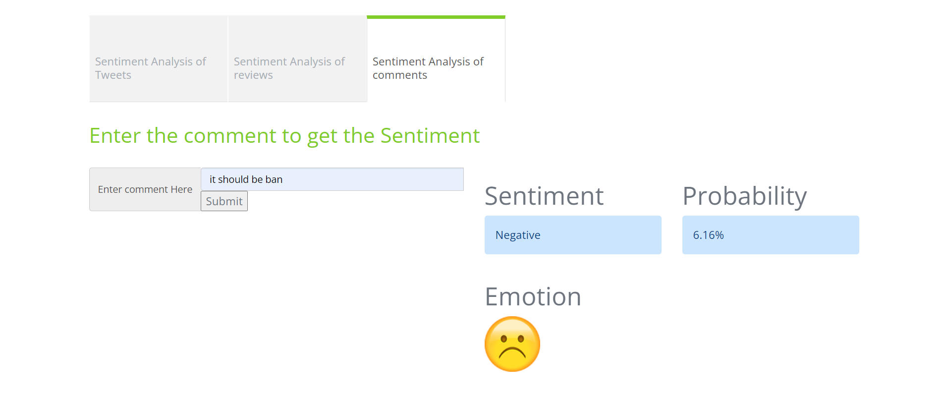
This result shows the output of sentence “It should be Ban”. Sentiment is positive and probability is 6.16%

Slide 16
Table 5: Accuracy of different model based on literature survey.
Dataset used in papers of literature survey | Other Model used in Papers of Literature Survey | Accuracy from the papers of Literature Survey
IMDB movie review | SVM Model | 79% [2]
Twitter review | Deep Neural Network Model | 91.18% [1]
Persian Movie Review | LSTM Model | 88.4% [3]
Consumer review | BiLSTM Model | 95.61% [4]
IMDB movie review | 1D-CNN Model | 82.86% [2]
IMDB movie review | 2D-CNN Model | 82.47% [2]

Slide 17
Table 6: Accuracy of LSTM model
Dataset | Model | Obtained accuracy
IMDB movie review | LSTM | 86.17%
Twitter review | LSTM | 93.05%
Social media | LSTM | 88.05%

Slide 18
Choosing the Right Parameters: The choice of parameters such as the number of top words to consider, the maximum review length, the size of the word embeddings, the number of LSTM units, and the dropout rate can significantly affect the model’s performance. Overfitting: LSTM models are powerful and have a high capacity, which makes them prone to overfitting, especially when the amount of training data is limited. Although dropout layers are used in the model to mitigate this issue. Training Time: LSTM models can be slow to train, especially when the number of epochs is large. This can make the process of model selection and hyperparameter tuning quite time-consuming. Interpretability: While LSTM models can achieve high performance on sentiment analysis tasks, they are often considered as “black box” models. Dependency on External Libraries: The program relies on several external Python libraries such as Keras and NLTK. Any changes or issues with these libraries can potentially affect the program. Hardware Requirements: Training deep learning models like LSTM requires significant computational resources (CPU/GPU), and not all systems may be equipped to handle these requirements.
LIMITATIONS

Slide 19
REFERENCES
[1] Iqbal, A., Amin, R., Iqbal, J., Alroobaea, R., Binmahfoudh, A., & Hussain, M. (2022). Sentiment analysis of consumer reviews using deep learning. Sustainability, 14(17), 10844.
[2] Dashtipour, K., Gogate, M., Adeel, A., Larijani, H., & Hussain, A. (2021). Sentiment analysis of persian movie reviews using deep learning. Entropy, 23(5), 596.
[3] Ramadhan, N. G., & Ramadhan, T. I. (2021). Analysis sentiment based on IMDB aspects from movie reviews using SVM. Sinkron: jurnal dan penelitian teknik informatika, 6(1), 39-45.
[4] Ullah, K., Rashad, A., Khan, M., Ghadi, Y., Aljuaid, H., & Nawaz, Z. (2022). A deep neural network-based approach for sentiment analysis of movie reviews. Complexity, 2022.
[5] ‘The Power of Social Media: Connecting and Engaging in the Digital Age,’ Times of India, 2024. Available: https://timesofindia.indiatimes.com/readersblog/elrashidy-media-group/the-power-of-social-media-connecting-and-engaging-in-the-digital-age-50585/. [Accessed: 14/02/2024].

Slide 20
[6] Fornacciari, P., Mordonini, M., & Tomaiuolo, M. (2015, June). A case-study for sentiment analysis on twitter. In WOA (pp. 53-58). [7] Tusar, M. T. H. K., & Islam, M. T. (2021, September). A comparative study of sentiment analysis using NLP and different machine learning techniques on US airline Twitter data. In 2021 International Conference on Electronics, Communications and Information Technology (ICECIT) (pp. 1-4). IEEE. [8] Saragih, M. H., & Girsang, A. S. (2017, November). Sentiment analysis of customer engagement on social media in transport online. In 2017 International Conference on Sustainable Information Engineering and Technology (SIET) (pp. 24-29). IEEE. [9] "IMDb Dataset of 50K Movie Reviews," Kaggle, 2019. [Online]. Available: https://www.kaggle.com/datasets/lakshmi25npathi/imdb-dataset-of-50k-movie-reviews/data. [Accessed: 16-03-2024] [10] LSTM Tutorial,’ Simplilearn, 2024. Available: https://www.simplilearn.com/tutorials/artificial-intelligence-tutorial/lstm. [Accessed: 14-03-2024] [11] "Twitter Sentiment Analysis: Hatred Speech," Kaggle, 2020. [Online]. Available: https://www.kaggle.com/datasets/arkhoshghalb/twitter-sentiment-analysis-hatred-speech. [Accessed: 16-03-2023].

Slide 21
[12] Prastyo, P. H., Sumi, A. S., Dian, A. W., & Permanasari, A. E. (2020). Tweets responding to the Indonesian Government’s handling of COVID-19: Sentiment analysis using SVM with normalized poly kernel. J. Inf. Syst. Eng. Bus. Intell, 6(2), 112. [13] Ressan, M. B., & Hassan, R. F. (2022). Naive-Bayes family for sentiment analysis during COVID-19 pandemic and classification tweets. Indonesian Journal of Electrical Engineering and Computer Science, 28(1), 375. [14] Bello, A., Ng, S. C., & Leung, M. F. (2023). A BERT framework to sentiment analysis of tweets. Sensors, 23(1), 506. [15] Gaurav Umesh Awate, Rushikesh Sanjay Dhus, Sanket Rajendra Gaikwad, Rohit Ravindra Lonkar, Prof. S.R. Bhujbal(2024). Sentiment Analysis on Social Media. [16] ‘The Power of Social Media: Connecting and Engaging in the Digital Age,’ Times of India, 2024. Available: https://timesofindia.indiatimes.com/readersblog/elrashidy-media-group/the-power-of-social-media-connecting-and-engaging-in-the-digital-age-50585/. [Accessed: 14/02/2024].

Slide 22
Questions?

